Slide 1
Key Predictors of Depression for Public Health Intervention
Max Gravenstein
May 1, 2025

Slide 2
Introduction
The goal of this project was to build a model to predict if someone had depression and identify the key factors that influence that prediction
This is valuable to public health organizations like Philadelphia’s DBHIDS in promoting good health and being stewards of taxpayer funds
To provide preventative care to those at high-risk of depression is far cheaper than managing complex mental health crises in institutional settings.

Slide 3
Data Source
Data is based on a real depression survey, with feature distributions that are similar but not identical to the original
Synthetic: The data is artificially generated, not collected directly from surveys, but based on a real survey – 140700 rows × 20 columns
Demographic: Individuals across India ages 18-60
Time-frame: Original survey conducted between January and June 2023

Slide 4
Methodologies - Tools and Data Preparation
Tools
Data Preparation
Python: The core programming language used
Pandas: For organizing and managing the data tables
Seaborn: For creating graphs to visualize the data and spot issues
Scikit-learn: For building the predictive model and checking its performance
Logistic regression: A powerful method for determining if a datapoint is in a category (i.e. has depression)
Handled missing information
Standardized messy categories
Removed non-predictive columns ('Name' + 'City')
Merged related information (e.g., 'Academic' + 'Work Pressure' into 'Pressure')
Converted text answers ('Yes'/'No', 'Male'/'Female', 'Sleep Duration',) into numbers
Adjusted scales so all factors were weighted fairly

Slide 5
Methodologies - The Model
Building the model
Checking Performance
Ensure a fair test by splitting clean data into a Training set (to teach the model) and testing set (to evaluate the model)
Used Logistic Regression, a standard statistical method for classification
Goal: Predict if someone has depression from the training data, then see how it predicts depression on the testing data
Tested the trained model on the unseen 'Test' data and measured performance with standard reports
The model correctly predicted the incidence or non-incidence of depression 94% of the time
Out of all the people who actually had depression, the model correctly identified 81% of them
Out of all the people who did not have depression, the model correctly identified 97% of them

Slide 6
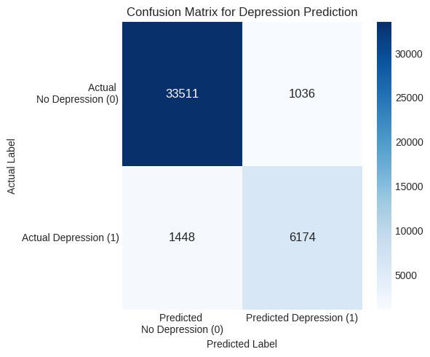
Methodologies

Slide 7
Conclusion
The model has high overall accuracy (94%), but it is better at identifying those without depression than those with it, missing about 19% of the positive cases.
The biggest risk factors for depression are - having had suicidal thoughts, financial stress, work and study pressure, and hours worked or studied
Suicidal Thoughts: reporting having had suicidal thoughts increases the odds of depression by 246%
Pressure: an increase in 1.40 units on a scale of 0 to 5 increases the odds of depression by 176%
Financial Stress: an increase in 1.41 units of on a scale of 0 to 5, increases the odds of depression by 116%
The biggest protective factors against depression are - age, not being a student, and having more work/study satisfaction
Age: an increase in age of 12.38 years on a scale of 18 to 65, decreases the odds of depression by 87%
Student-Professional: being a working professional compared to a student decreases the odds of depression by 54%
Satisfaction: an increase of 1.41 units on its scale of 0 to 5, decreases the odds of depression by 44%

Slide 8
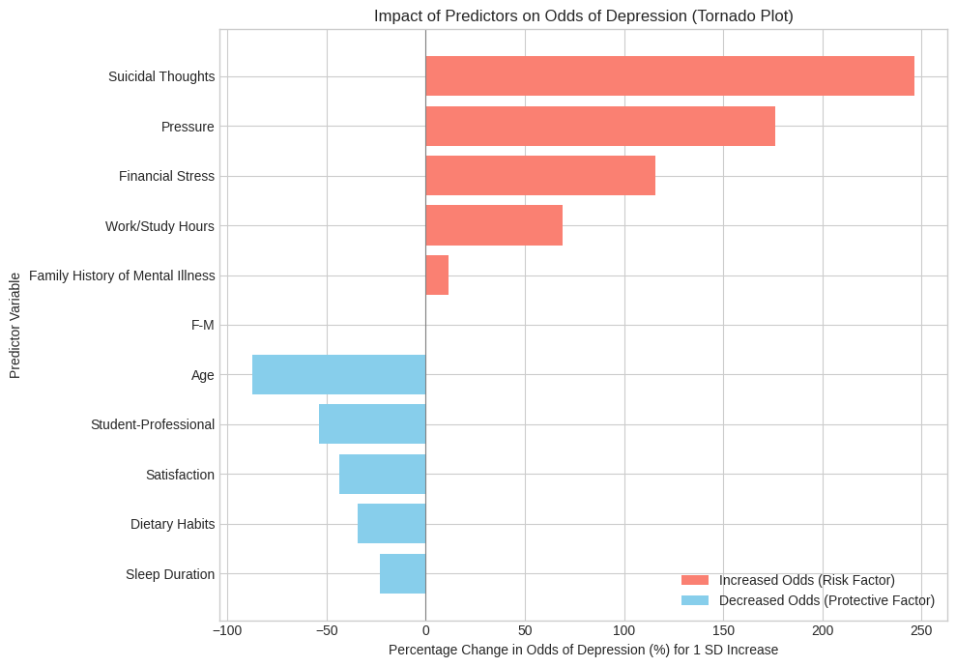
Conclusion - Cont.

Slide 9
Conclusion - Cont.
After accounting for major stressors, lifestyle factors of sleep and diet are moderately associated with lower depression odds
Dietary Habits: an increase in dietary habits score of 0.80 units (coded unhealthy - 1, moderate - 2, healthy - 3) decreases the odds of depression by 35%
Sleep Duration: an increase in sleep of 1.9 hours on a scale of 4 to 9, decreases the odds of depression by 23%
Family history of mental health has very little effect on someone’s likelihood of showing depression
The model suggests when holding other variables constant, gender is not predictive of depression – women are said to have higher incidence of depression than men, but the model suggests women just have more risk factors for depression
F-M (Gender): no significant association with the odds of depression in this model.
A model like this could be used to influence survey questions DBHIDS asks during intake. It may be used to support a depression prevention protocol that could include courses in mindfulness to reduce reported stress, financial literacy, and tips on maintaining a healthy diet on a budget

Slide 10
Questions?

Slide 11
References
https://www.kaggle.com/competitions/playground-series-s4e11/overview

Slide 12
Appendix - Model Interpretation
F-M (Gender): no significant association with the odds of depression in this model
Age: an increase in age of 12.38 years on a scale of 18 to 65, decreases the odds of depression by 87%
Student-Professional: being a working professional compared to a student decreases the odds of depression by 54%
Sleep Duration: an increase in sleep of 1.9 hours on a scale of 4 to 9, decreases the odds of depression by 23%
Dietary Habits: an increase in dietary habits score of 0.80 units (coded unhealthy - 1, moderate - 2, healthy - 3) decreases the odds of depression by 35%
Suicidal Thoughts: reporting having had suicidal thoughts increases the odds of depression by 246%
Work/Study Hours: an increase in 3.85 hours on a scale of 0 to 12, increases the odds of depression by 69%
Financial Stress: an increase in 1.41 units of on a scale of 0 to 5, increases the odds of depression by 116%
Family History of Mental Illness: having a family history increases the odds of depression by 12%
Pressure: an increase in 1.40 units on a scale of 0 to 5 increases the odds of depression by 176%
Satisfaction: an increase of 1.41 units on its scale of 0 to 5, decreases the odds of depression by 44%

